Slide 1
MovieLens-100k
&
IMDb Movies Recommendation
Ben Li, Esther Ho, Lawrence, Marco Chan

Slide 2
Business Application
On MovieLens 100k :
Build a Hybrid recommendation engine to recommend relevant movies to different users
Explore Recommendation Models in details, understand strengths and weaknesses of each model, build a hybrid model to improve model performance and accuracy.
On IMDb movies :
Collect data from IMDb website ;
Construct a content-based recommendation system for recommender ;
Recommend recent movies to users by chatbot

Slide 3
Agenda
MovieLen 100K
01
Recommendations System
02
IMDb Web-scraping
03
Movie-Bot
04
A glance through the dataset
3 Approaches for Recommendations
Obtain updated movie data
Created chatbot by RASA,
Incorporated with recommendation system

Slide 4
01
MovieLens 100K

Slide 5
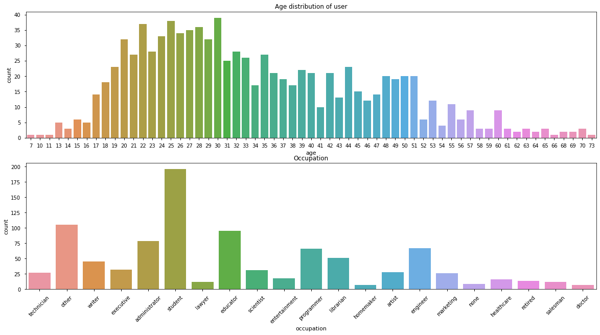
MovieLens 100K - Information
943 Users

Slide 6
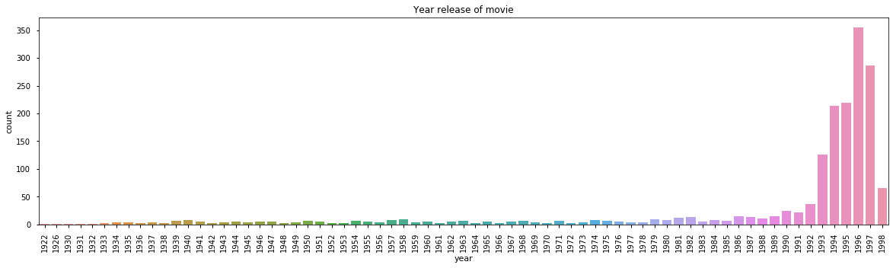
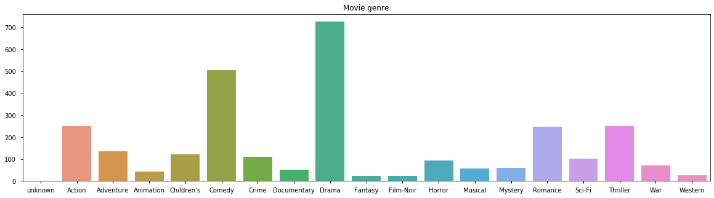
MovieLen 100K - Information
1682 Movies

Slide 7
02
Recommendations System

Slide 8



3 Approaches for Recommendations
Content-based
Collaborative
item-item
user-user
Matrix factorization
Find movies according to their genre similarity
Find users who have similar ratings with the targeted user
Recompose the rating matrix by using matrix factorization

Slide 9
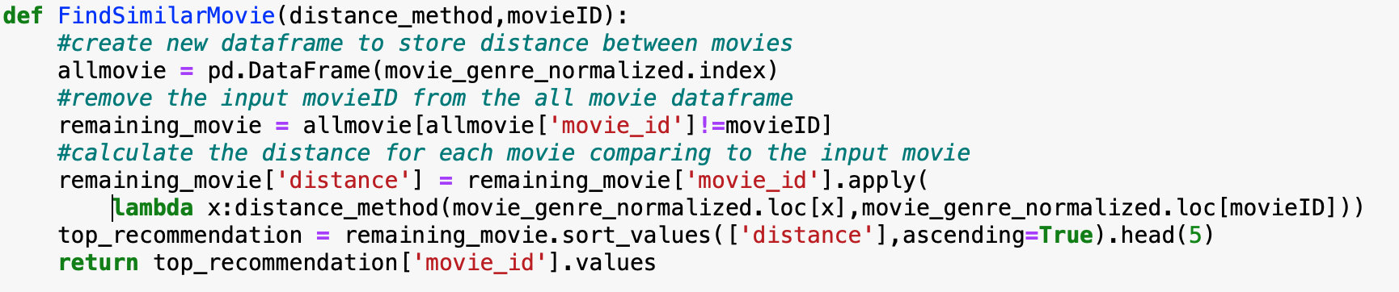
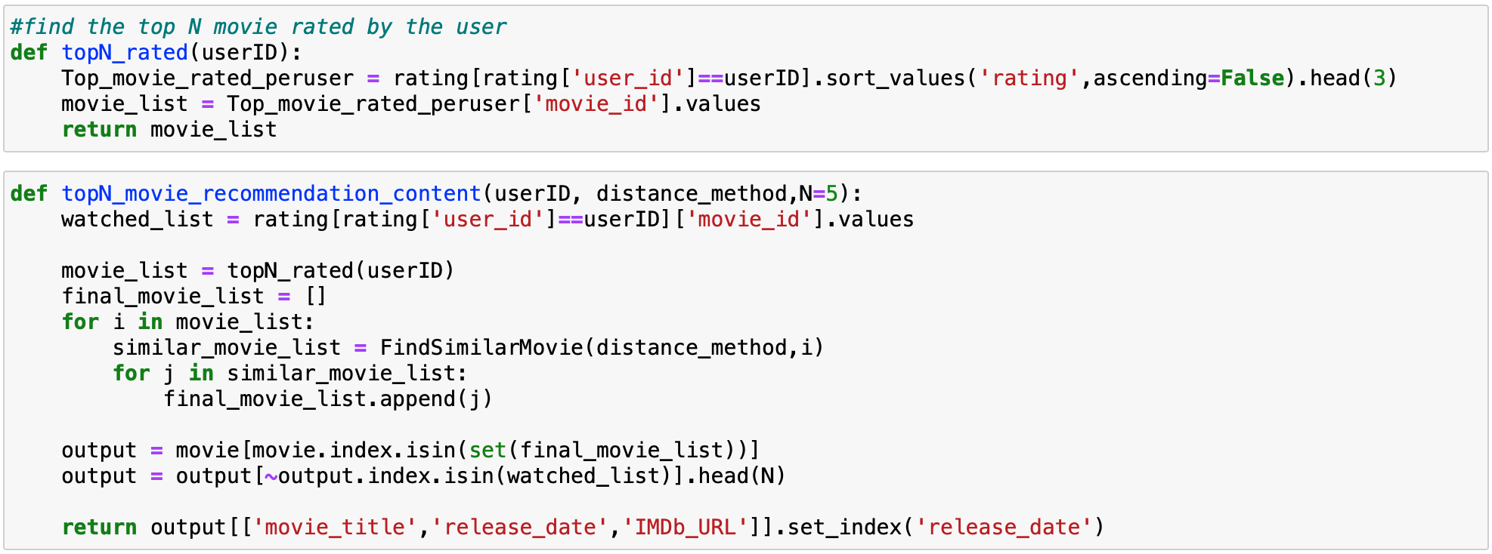
Content-based (item-item)
item-item
Find movies according to their genre similarity

Slide 10
Distance methods comparison
Euclidean Distance
Cosine Similarity
Pearson’s Coefficient
Advantages
Disadvantages
Applications
Common and good for datasets that are compact or isolated clusters
Easy to implement and test
Both continuous and categorical variables can be used
Accuracy score increases when data is not normalized
Sensitive to outliers
Not efficient for image data
Not efficient with nominal data
Sensitive to outliers
K-means algorithm
Involving internal data
DNA Analysis
Health Psychology Analysis
Often used in collaborative filtering recommendation systems
Document similarity
Text Mining
Information Science

Slide 11
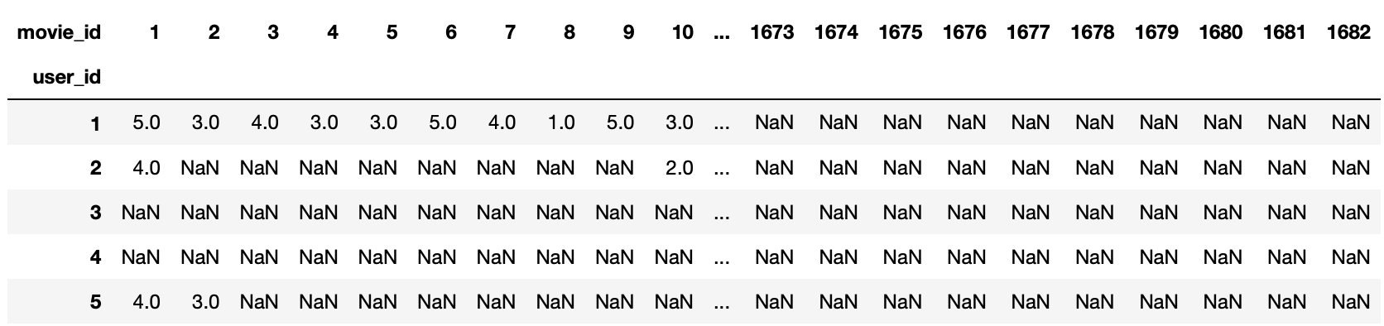
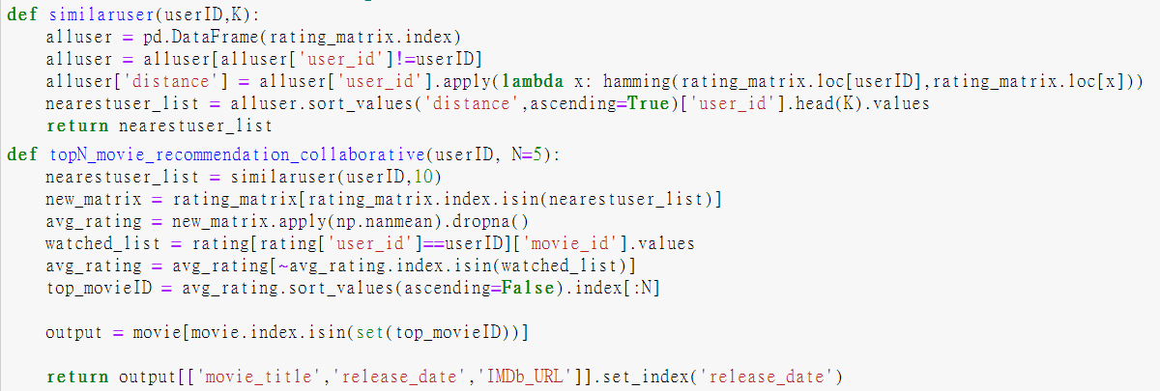
Collaborative-based (user-user)
user-user
Find users who have similar ratings with the targeted user

Slide 12
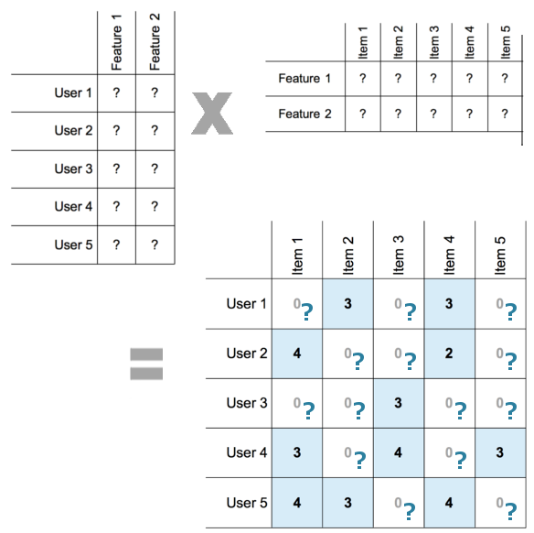
Surprise
Matrix factorization
Based algorithm
Singular Value Decomposition (SVD)
Matrix factorization
Non-negative Matrix factorization
Low-rank matrix approximation
Recompose the rating matrix by using matrix factorization

Slide 13
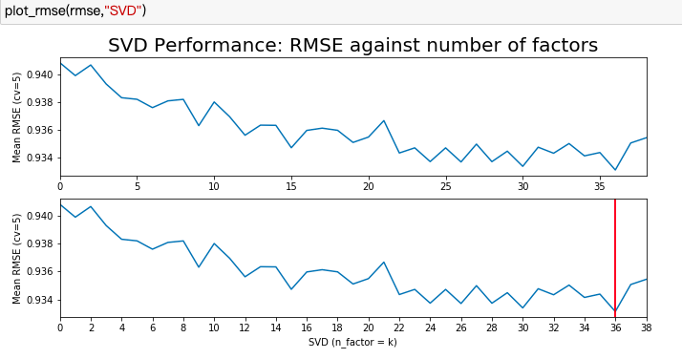
Finding the smallest RMSE

Slide 14
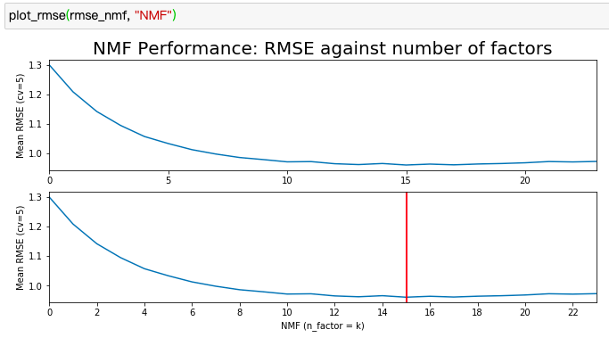
Finding the smallest RMSE

Slide 15
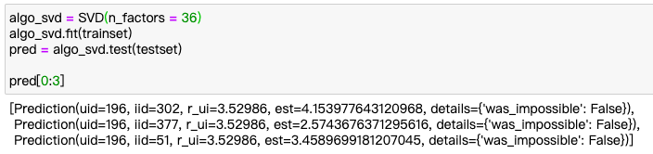
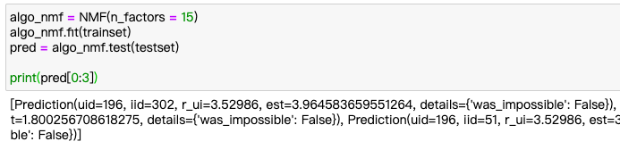
Train the Model (n_factors = lowest RMSE)

Slide 16
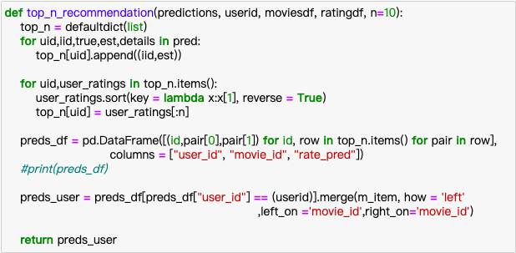
Recommendation by the model

Slide 17
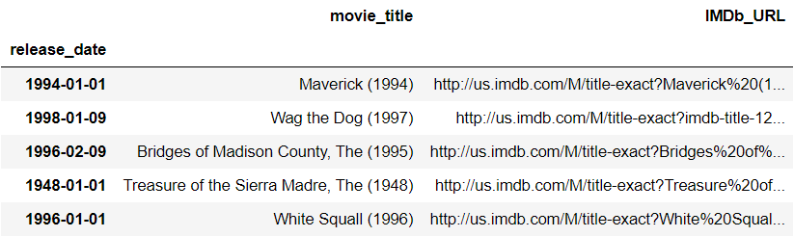
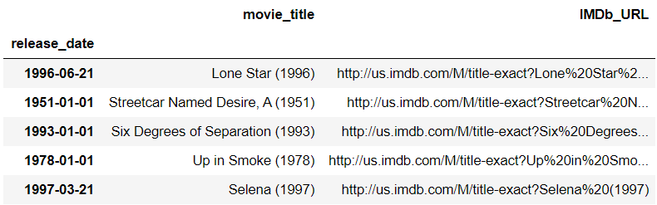
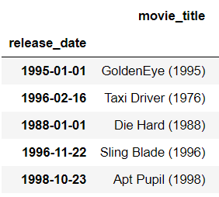
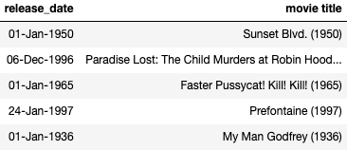
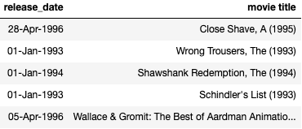
Hybrid Recommendations (user ID 186)
Content-base
User Background
User Rating
Item-Item
NMF
SVD
Collaborative

Slide 18
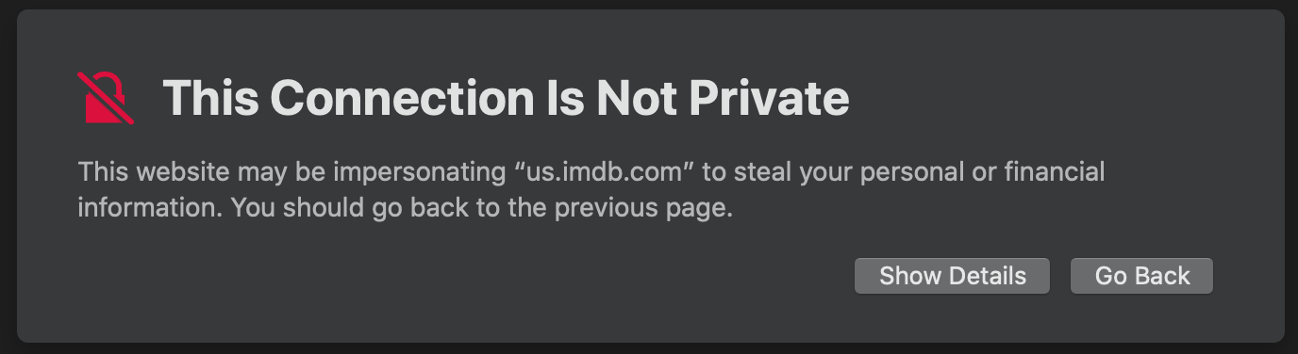
Limitation of the dataset
The latest movie was release in 1998
The movie URL cannot be properly accessed.

Slide 19
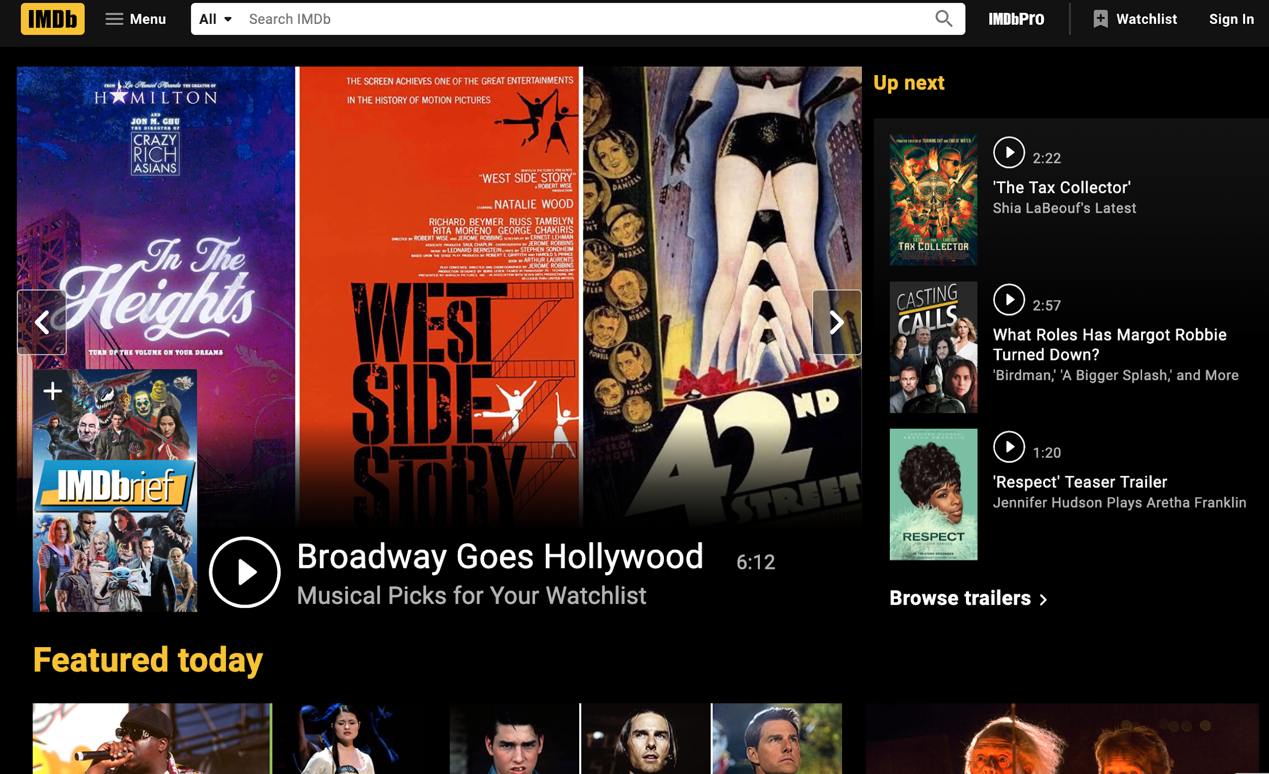
IMDb Web-scraping
03

Slide 20
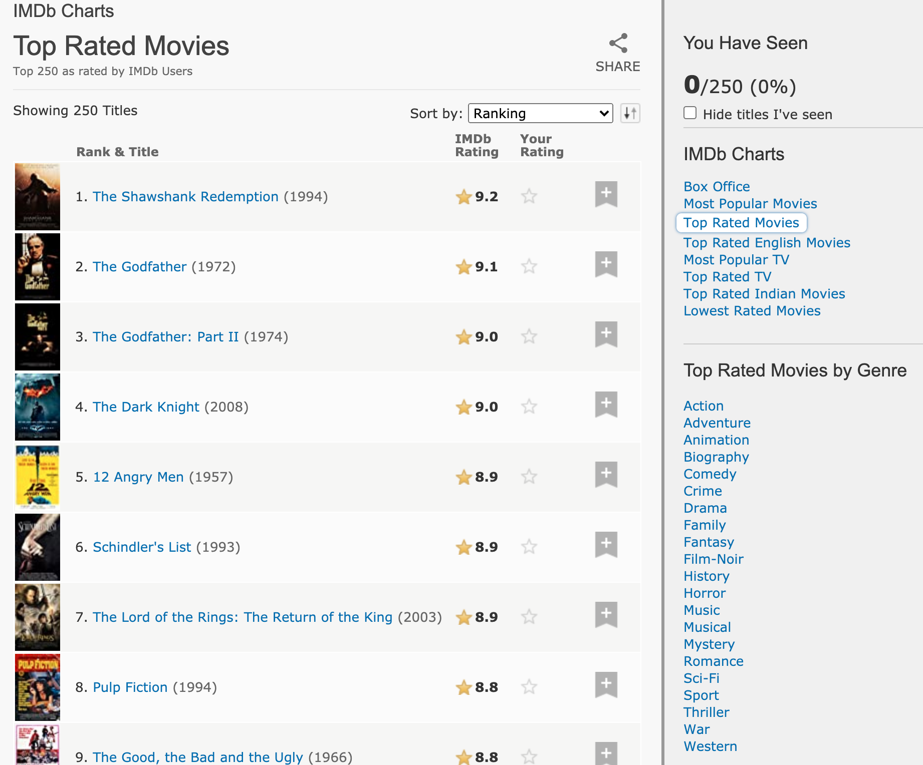
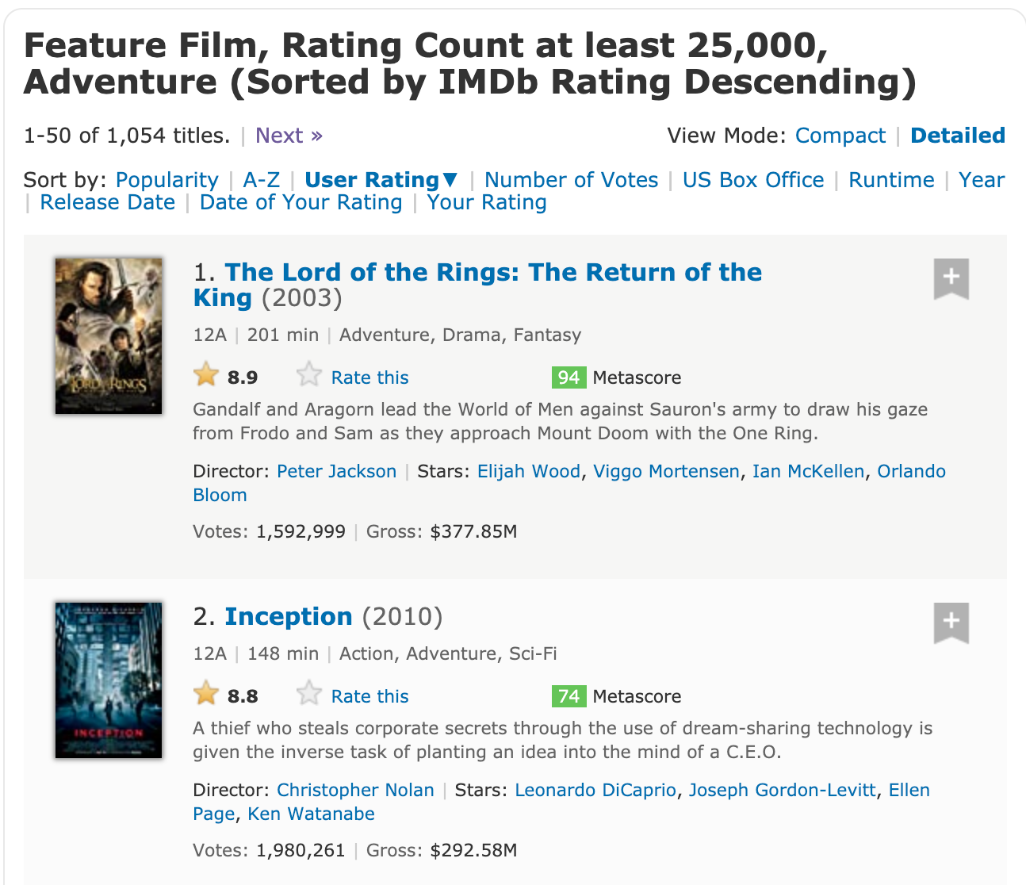
IMDb Website
Source: https://www.imdb.com/?ref_=nv_home

Slide 21
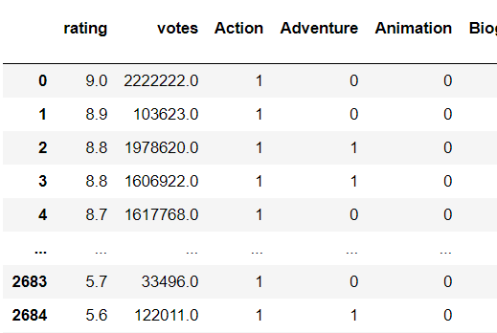
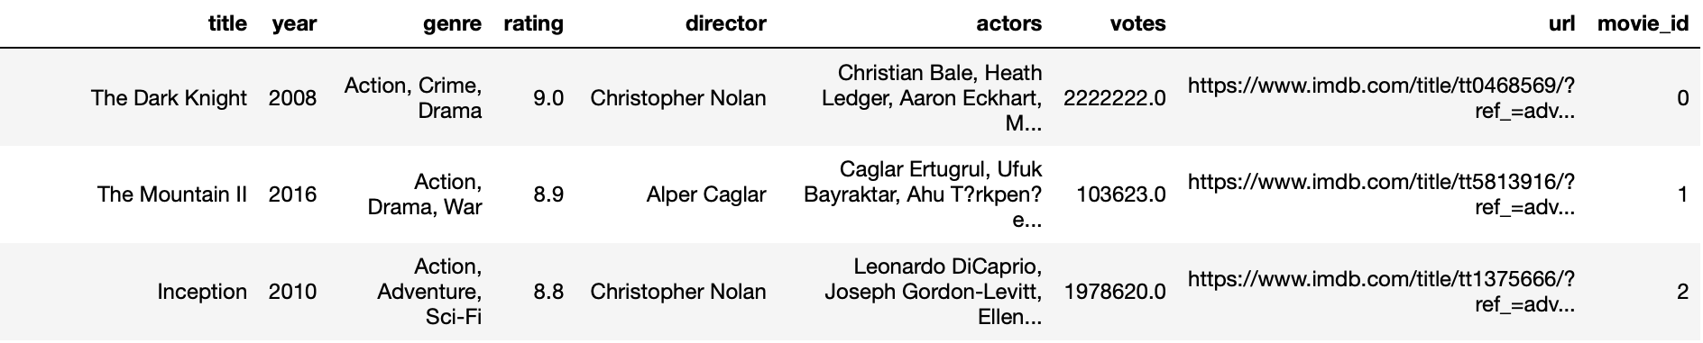
Overview of scraped-data
The scraped data is up-to-date and of highest rating
Implement to rasa chatbot for recommender to end-user
Preprocessing:
MultiLabelBinarizer was used for feature extraction
Remove duplicated movies result

Slide 22
Movie-Bot
04
Movie-Bot

Slide 23


RASA-Dialogue Flow
Ask for favorite movie
Search movie name in table
Get Recommendation
Obtain extra info from API
Link to Slack
1
2
3
4
5

Slide 24
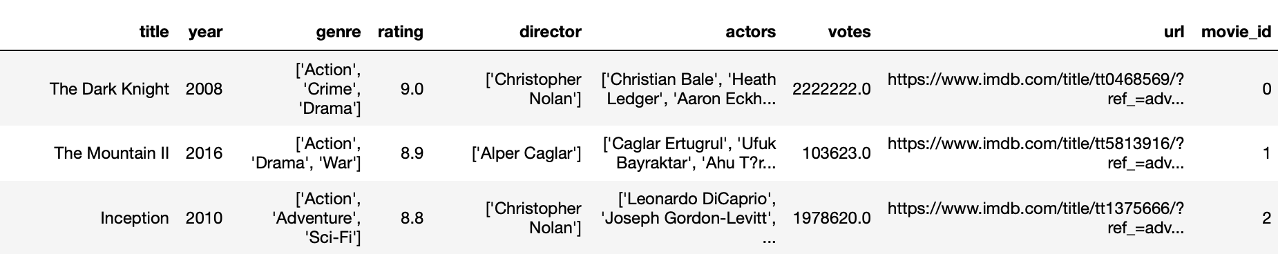
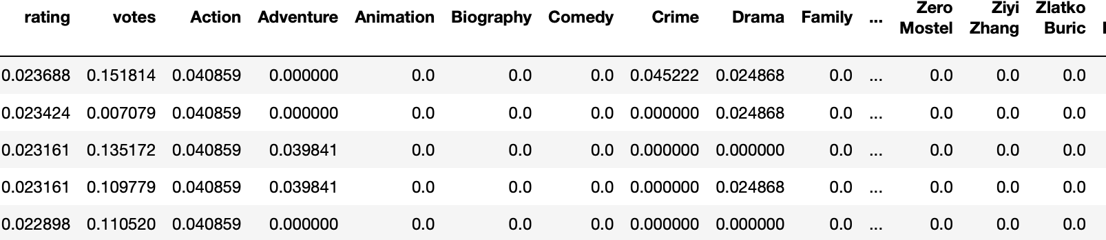
Search movie name in table
2
Output files: df_imdb & df_imdb_normalized

Slide 25
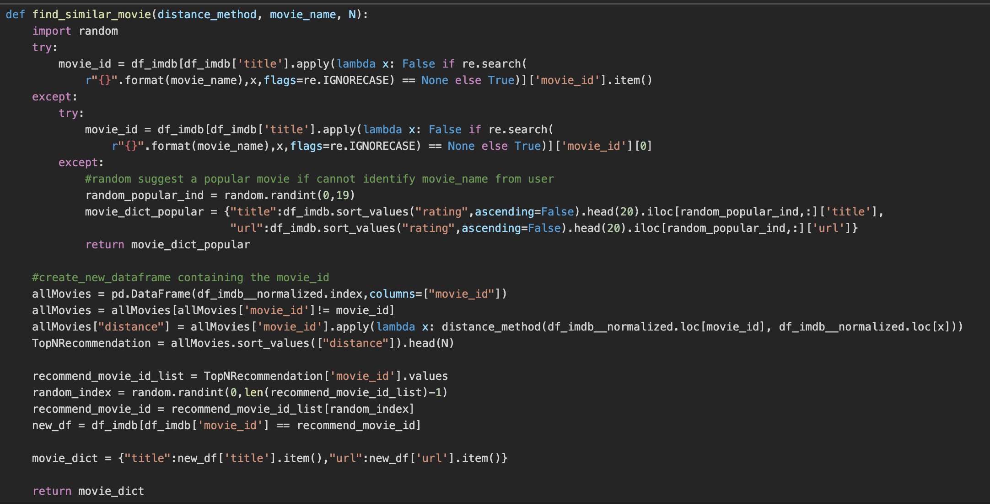
Search movie name in table
2
Search the movie name by using Regex:
If user provides searchable movie name in dataframe
return similar movies with highest rating
If the movie name is not searchable
return random movie with the top rating

Slide 26
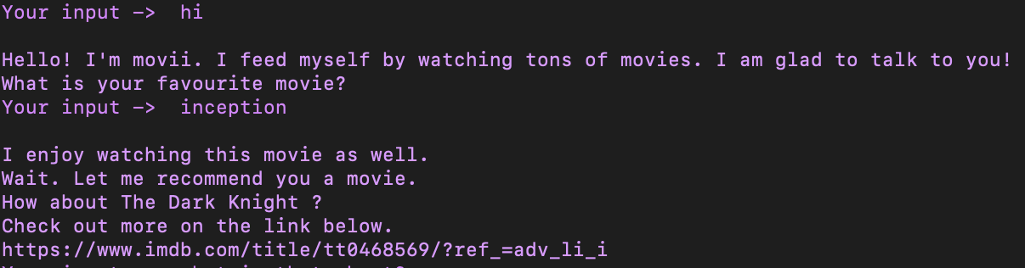
Get Recommendation
3
Similar movie with top rating is suggested
Genre, directors, actors, votes, rating
Increase the randomness of movie recommendation
Select one from the top N movie list

Slide 27
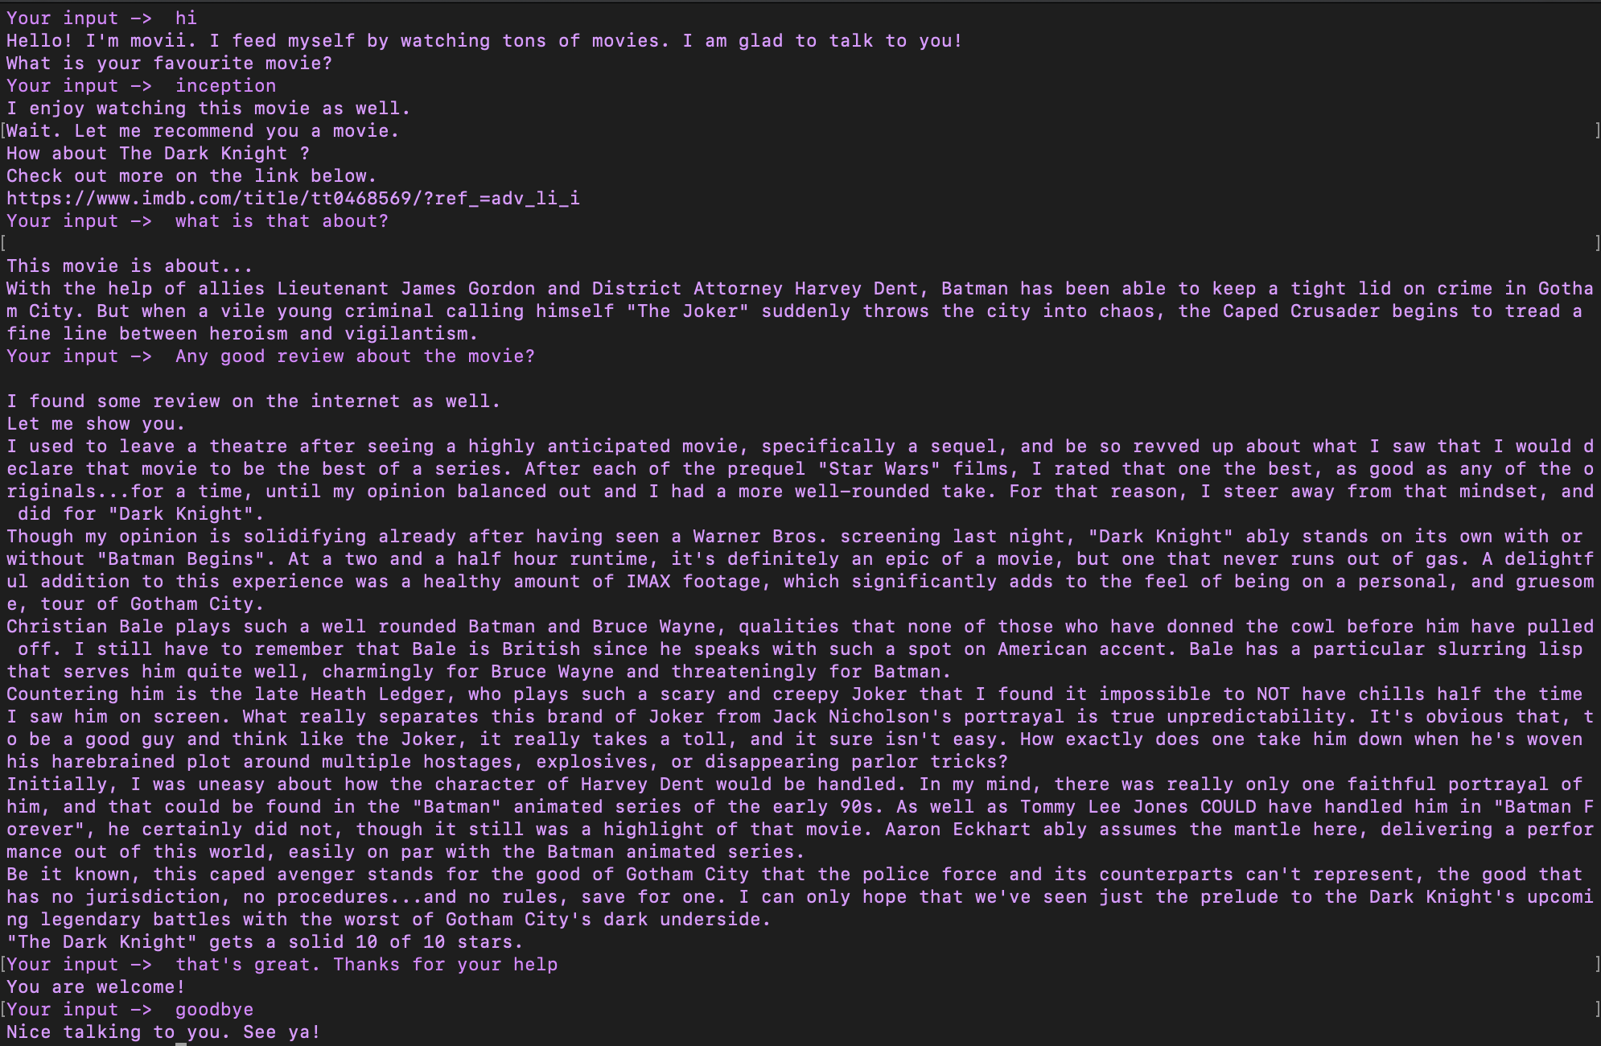
Obtain extra info from API
4
Plot of the movie
Movie Review

Slide 28
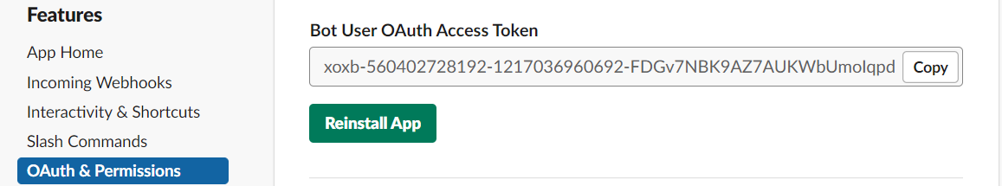
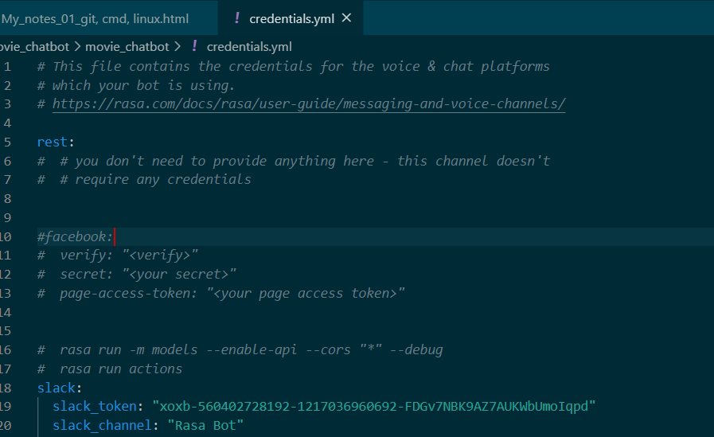
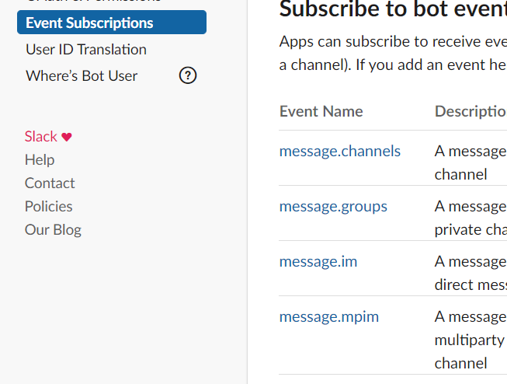
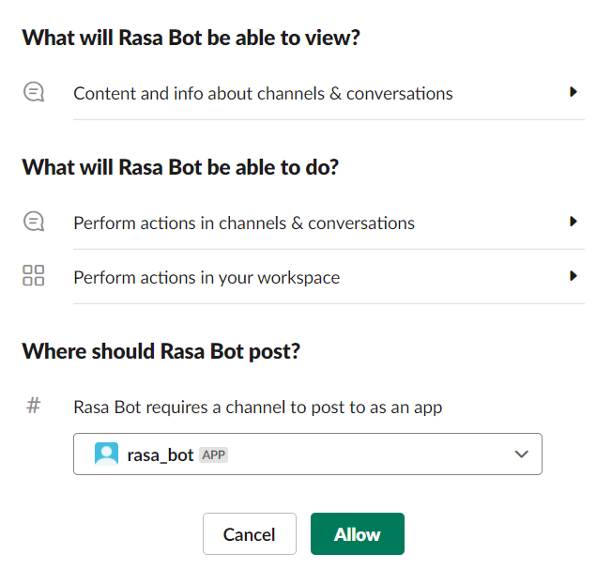
Link Movie-Bot to Slack
5
Install the app to Slack and obtain the authkey
Edit the credential.yml
Setting up bot event & integrate to slack by reinstalling

Slide 29
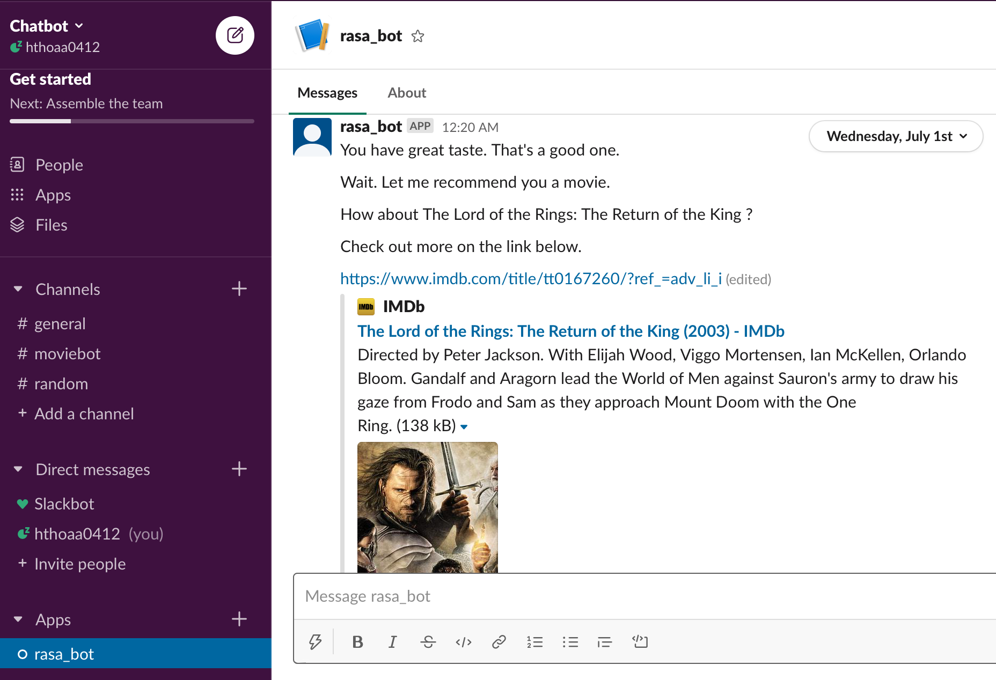
Link Movie-Bot to Slack
5

Slide 30
Challenges & Future Improvement
The Slack version RASA has a ‘looping’ problem in calling the API
Integrate different recommender systems into RASA
Conduct sentiment analysis on review comments
challenges
Future
Improvement

Slide 31
Welcome for Q & A
Special thanks to Slidesgo for the design of slides...

